Slide 1


ERASMUS TANDEM
Bridging Experiences:
peer-to-peer orientation meetings for incoming and outgoing students

Slide 2


THE IDEA
The Erasmus Tandem project aims to support and guide Faculty students throughout their mobility journey, building a bridge between incoming and outgoing students. All this allows to:
INTEGRATION
SHARING
KNOWLEDGE
The project develops through structured meetings with an informal atmosphere, aimed at encouraging interaction between students who are brought together by the international mobility experience.
“Un’opportunità unica per creare legami”

Slide 3



HOW DOES IT WORK?
INPUT
TANDEM
During the registration period, incoming students and Faculty grant winners fill out their respective Google Forms, entering their university of origin or destination.
Each student receives confirmation of their assigned meeting session.
Form responses automatically flow into a spreadsheet that cross-references data and common universities in real time.
PROCESSING

Slide 4
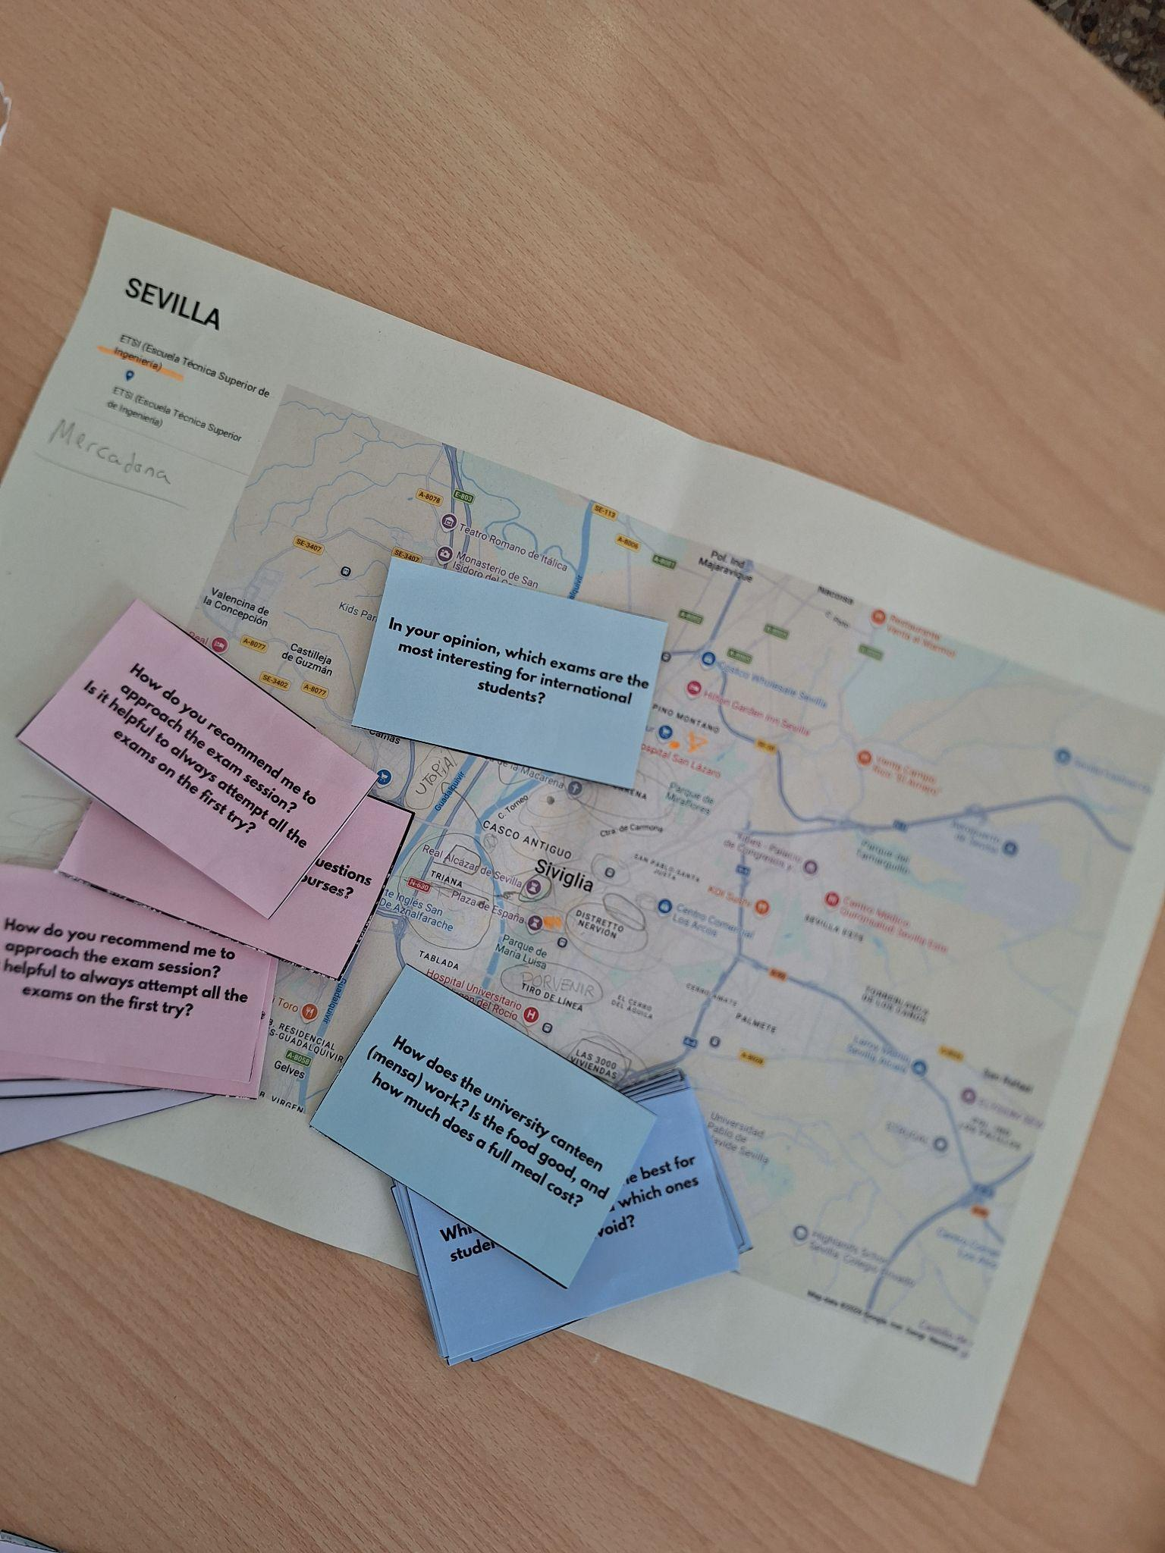


HOW DOES IT WORK?
The meeting is divided into 3 thematic blocks:
CITY
UNIVERSITY
EXCHANGE
City maps and icebreaker questions will guide the conversation, helping students to connect right from the start.
The meetings take place during the months of October and May.
Each meeting last 1,5-2 hours.

Slide 5
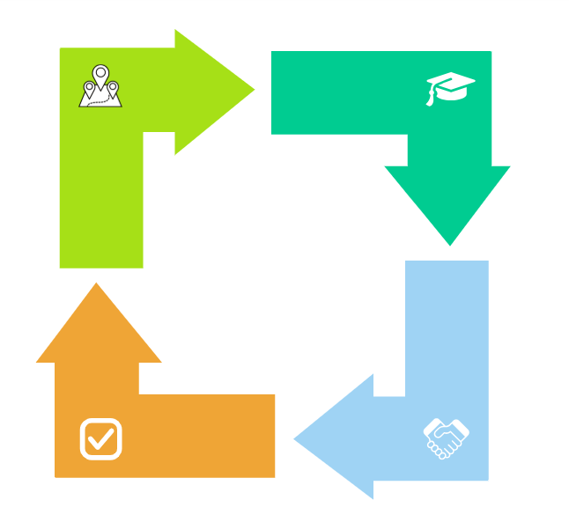
WHY JOIN?
The advantages for outgoing students
Get logistical advises
where to look for housing
public services
Get academic information
university life
courses and exams
Reducing the anxiety of facing a new experience
Having a go-to person at the host university

Slide 6

WHY JOIN?
The advantages for incoming students
Student integration
Academic support
Local tips
Language practice and networking

Slide 7
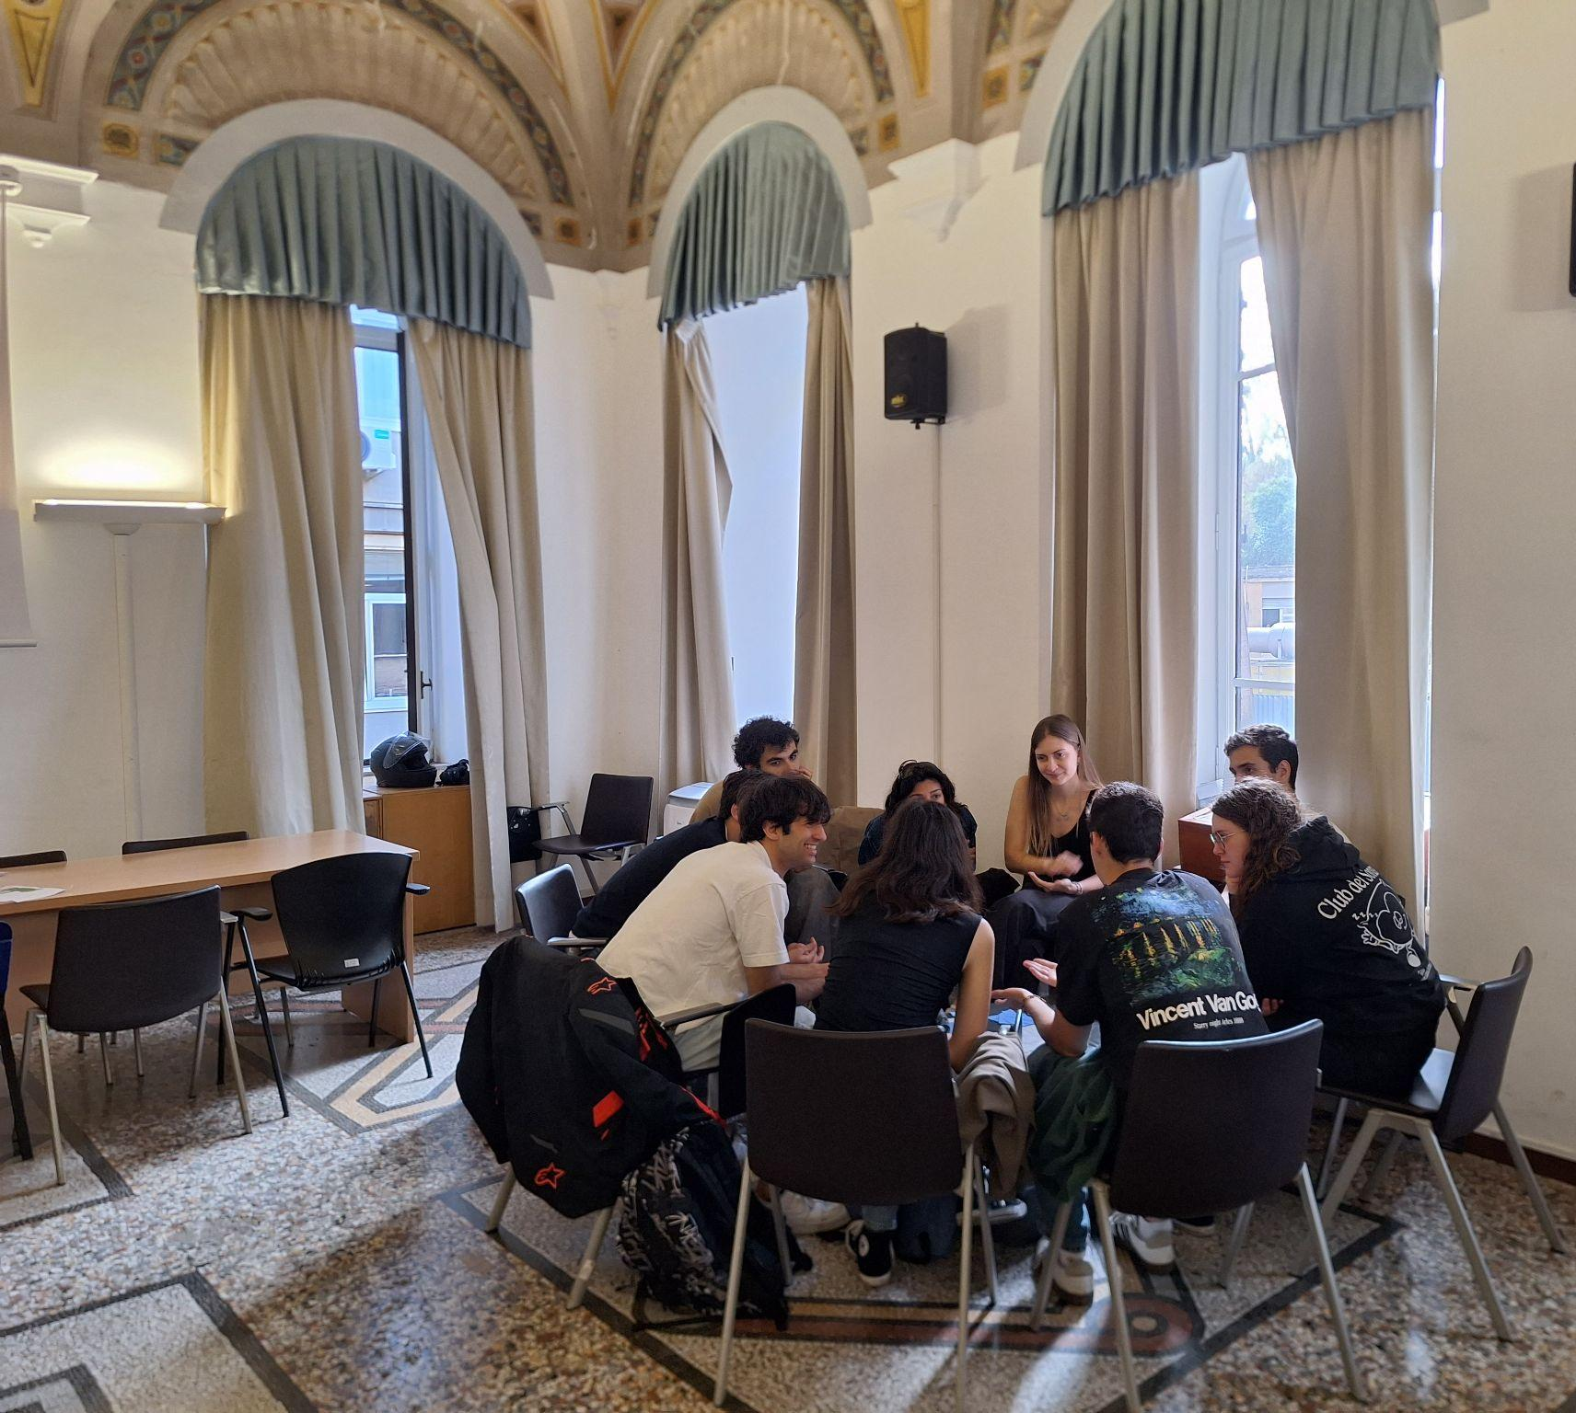
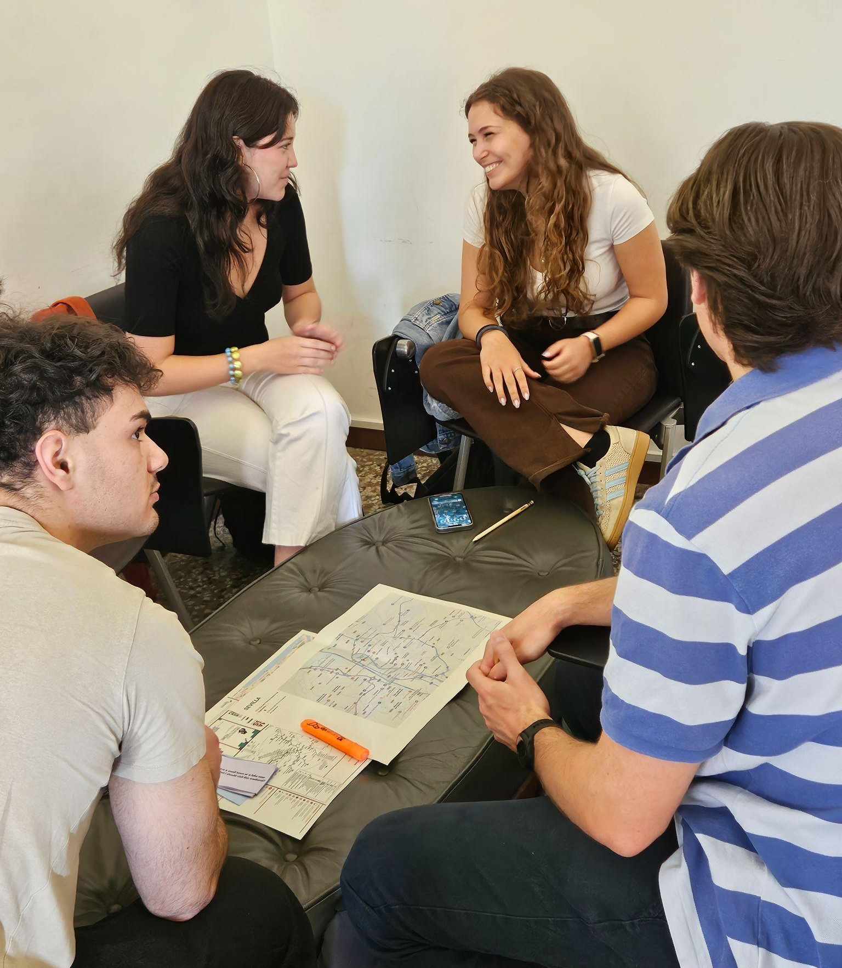
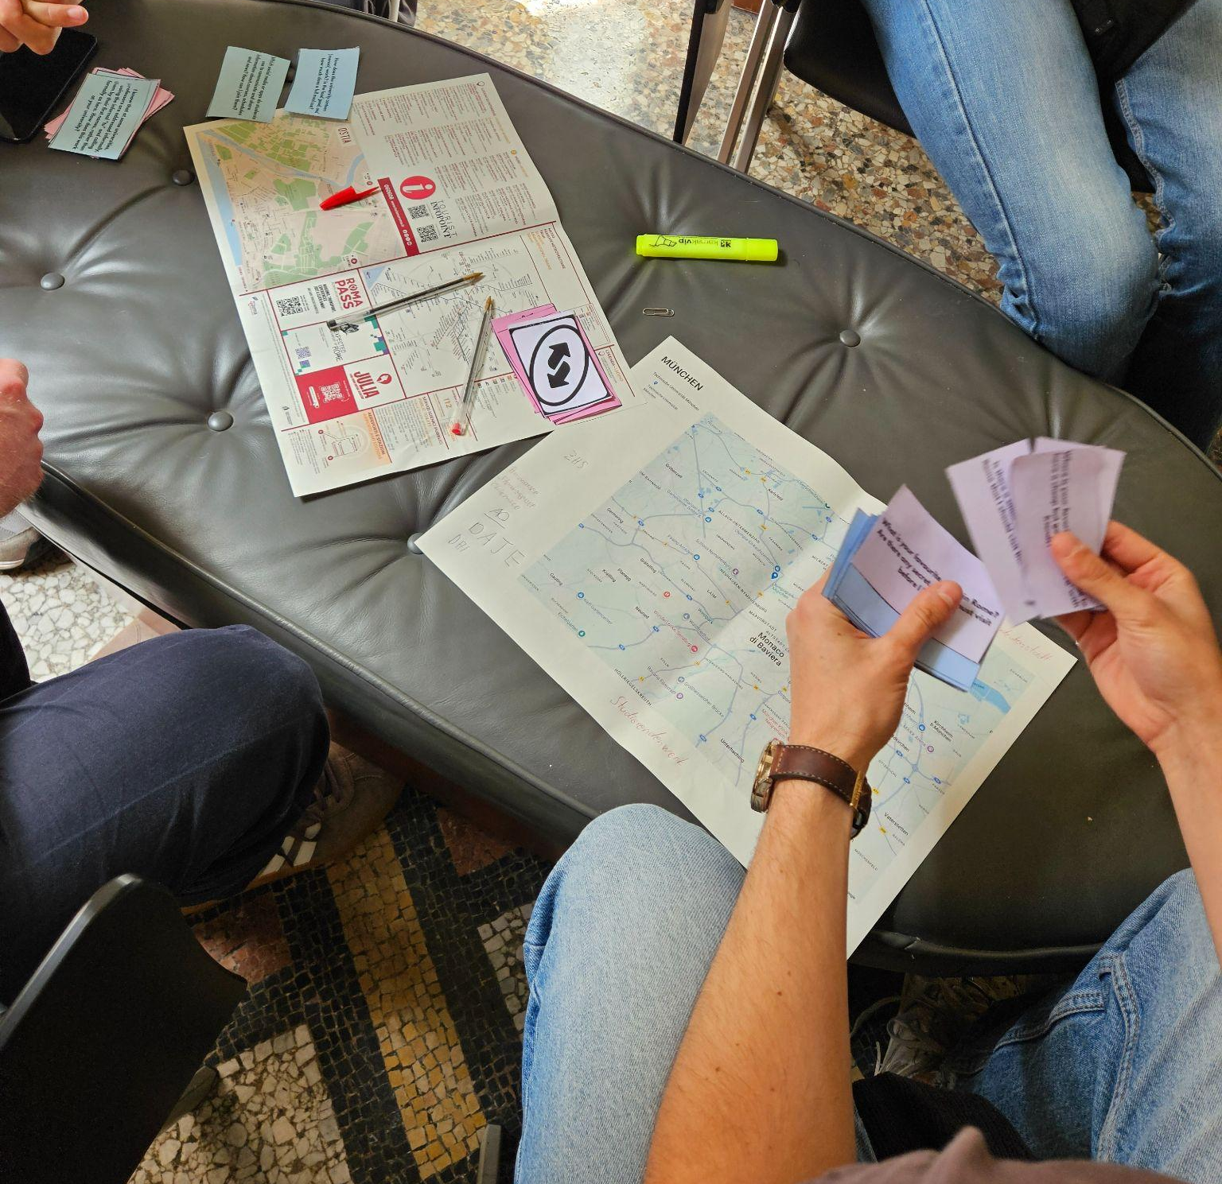
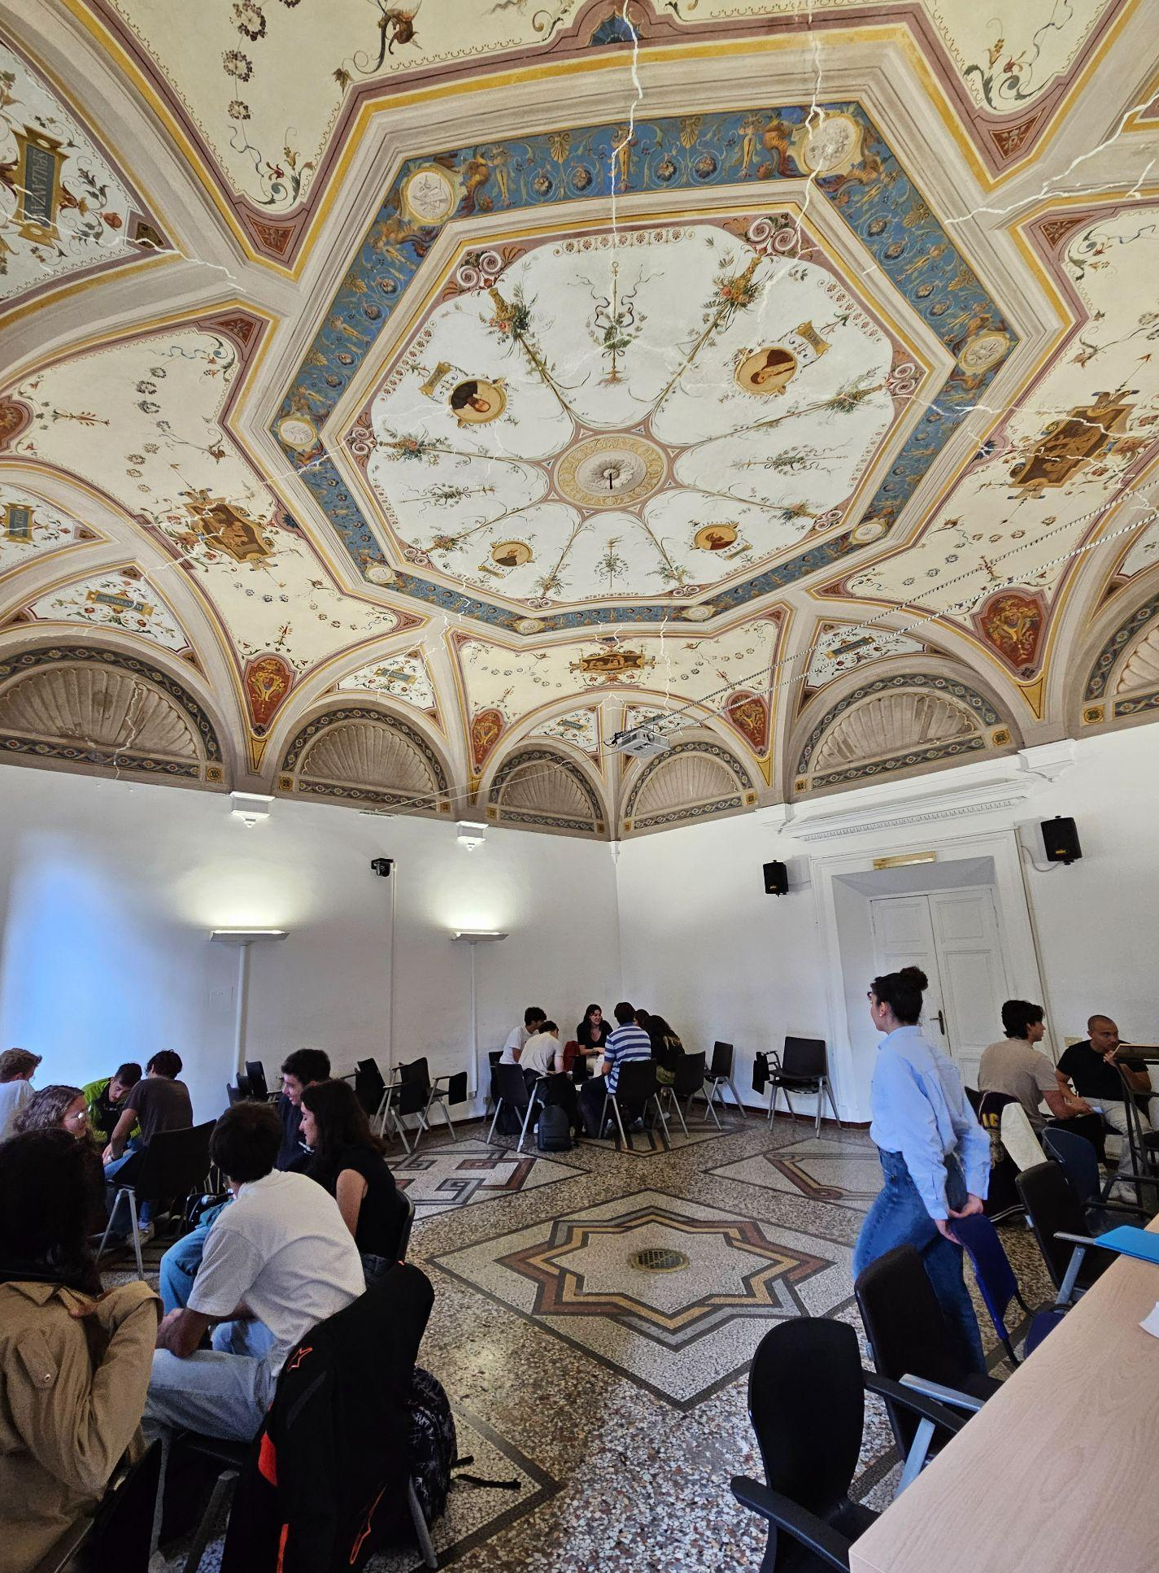
OUR MEETINGS

Slide 8
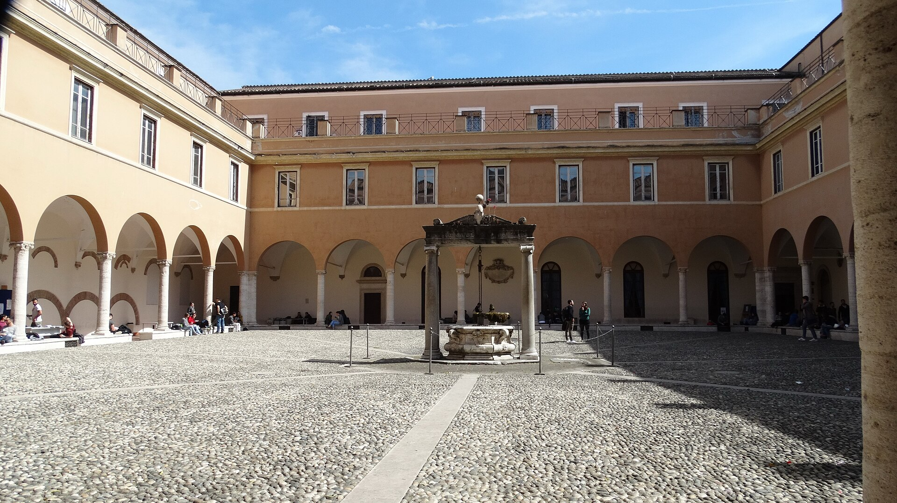
JOIN THE
TANDEM
every journey is the beginning of a story
The project is the result of the commitment of two students who wanted to build a bridge between those leaving and those arriving, developing a tandem system designed by students, for students.

